Slide 1

White blood cells Classification
Taisgaly Velez

Slide 2

Introduction
Clinical laboratories
Dataset of 17,092 images

Slide 3
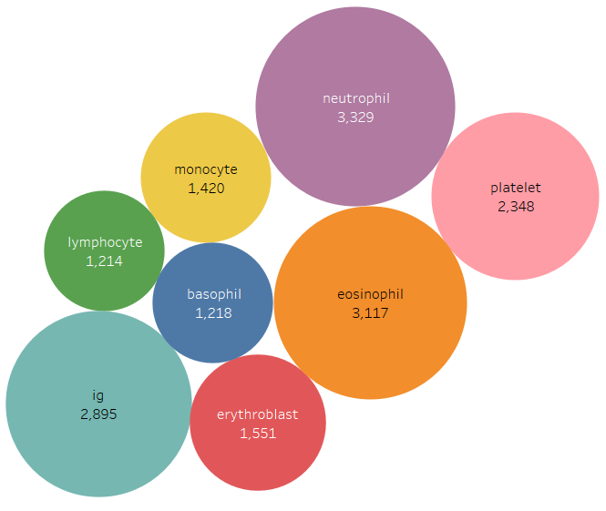

Slide 4
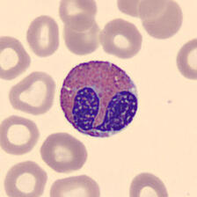
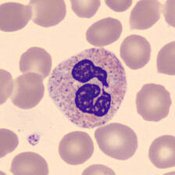
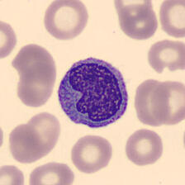
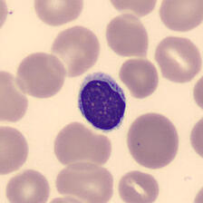
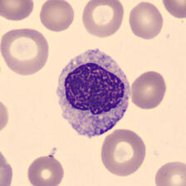
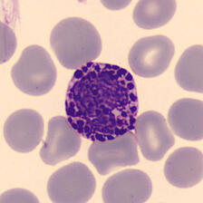
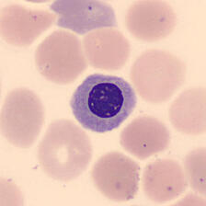
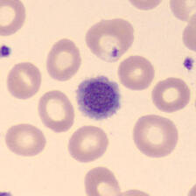
eosinophil
neutrophil
monocyte
lymphocyte
ig
basophil
erythroblast
platelet

Slide 5
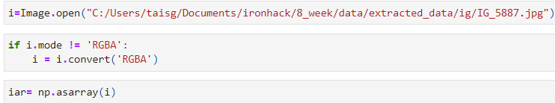
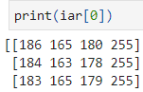
code

Slide 6
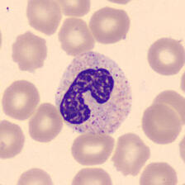
Model prediction
Sklearn
Support Vector Classifier (SVC)
Accuracy = 89%
neutrophil

Slide 7
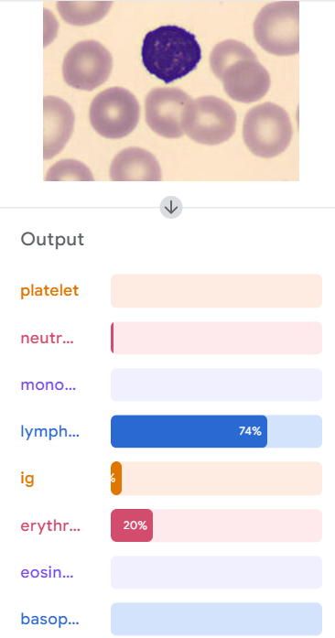
Teachable machine with google
Accuracy = 95%

Slide 8

Analysis and findings
TensorFlow is better

Slide 9

Future machine learning model
TensorFlow
Patients with other conditions

Slide 10

Thank you

